Slide 1
Fourier Methods
9th November 2020

Slide 2
Outline
Fourier Series
Application of Fourier Sine Series to a Triangular Function
Application to the Energy in the Normal Modes of a Vibrating String
Fourier Series Analysis of a Rectangular Velocity Pulse on String
The Spectrum of a Fourier Series
Fourier series to Fourier Integral
Fourier Transform

Slide 3
Fourier Series
Any function which repeats itself regularly over a given interval of space or time is called a periodic function; e.g. f(x) = f(x±α) where α is the interval or period.
Almost all periodic functions of interest using the method of Fourier Series may be represented by the series,
Fourier series of a square wave

Slide 4
Fourier Series in several equivalent forms

Slide 5
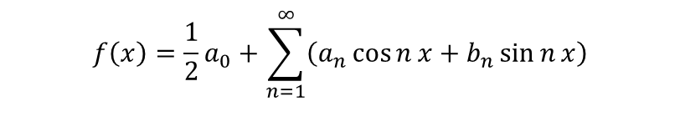
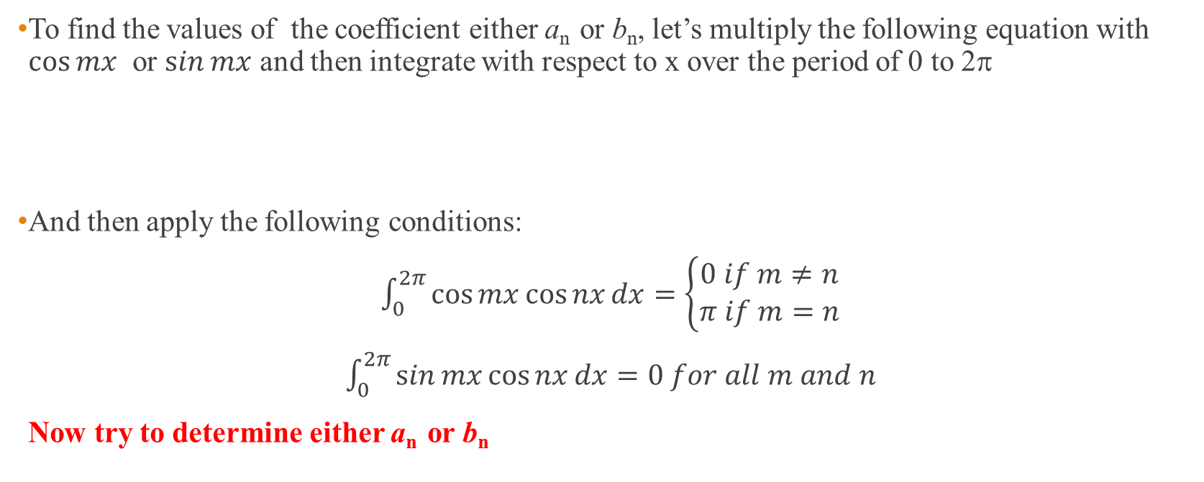
Coefficients of a_{n} and b_{n}
To find the values of the coefficient either a_{n} or b_{n}, let’s multiply the following equation with $\cos{mx}$ or $\sin{mx}$ and then integrate with respect to x over the period of 0 to 2π
And then apply the following conditions:
$\int_{0}^{2π}{\cos{mx}\cos{nx}dx=\left\{\begin{matrix}0 if m≠n \\ π if m=n\end{matrix}\right.}$
$\int_{0}^{2π}{\sin{mx}\cos{nx}dx=0 for all m and n}$
Now try to determine either a_{n} or b_{n}
$$f\left(x\right)=\frac{1}{2}a_{0}+\sum_{n=1}^{∞}{\left(a_{n}\cos{n}x+b_{n}\sin{n}x\right)}$$

Slide 6
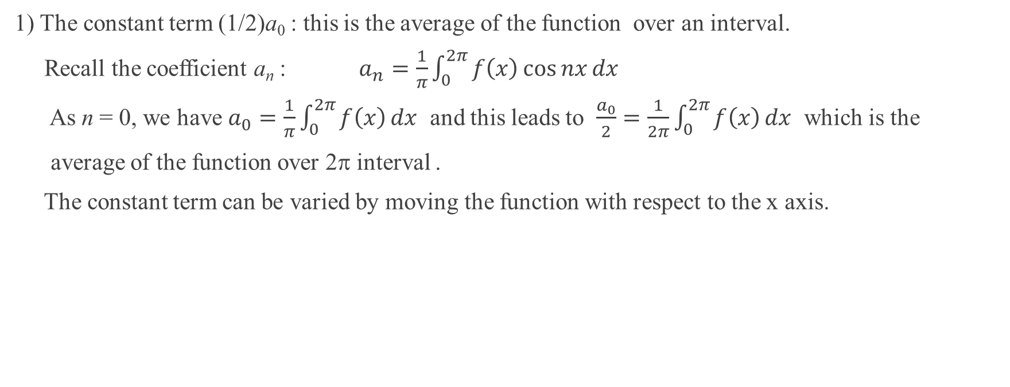
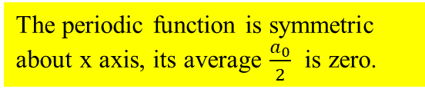
Interpretation of the Fourier Series (1)
1) The constant term (1/2)a₀ : this is the average of the function over an interval.
Recall the coefficient a_{n} : $a_{n}=\frac{1}{π}\int_{0}^{2π}{f\left(x\right)}\cos{nx}dx$
As n = 0, we have $a_{0}=\frac{1}{π}\int_{0}^{2π}{f\left(x\right)}dx$ and this leads to $\frac{a_{0}}{2}=\frac{1}{2π}\int_{0}^{2π}{f\left(x\right)}dx$ which is the
average of the function over 2π interval .
The constant term can be varied by moving the function with respect to the x axis.
The periodic function is symmetric about x axis, its average $\frac{a_{0}}{2}$ is zero.

Slide 7
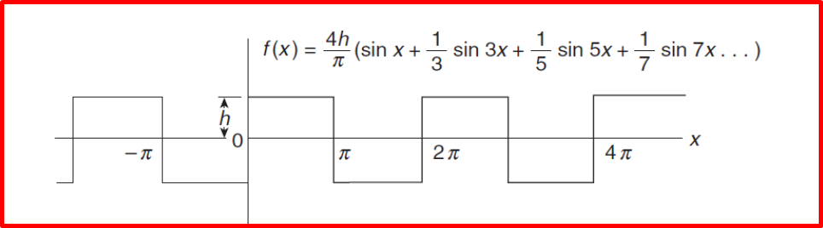
Interpretation of the Fourier Series (2)
2) Generally, Fourier series is represented by the combination of even and odd parts. Whether the function is completely even (f(x) = f(-x)) or completely odd (f(x) = -f(-x)) can often determined by the position of the y-axis.
For example
This periodic function is represented by odd function with zero constant.
This periodic function is represented by even function with zero constant.

Slide 8
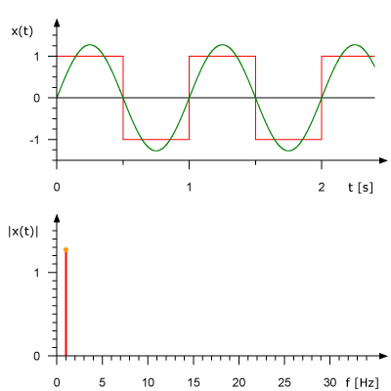
Interpretation of the Fourier Series (3)
3) Terms in the series and their combination are responsible for the shape of the series representation.
The fundamental or first harmonic has the frequency of the square wave.
The higher frequencies build up the squareness of the waves.
The highest frequencies are responsible for the sharpness of the vertical sides of the waves.
The more the higher frequency components are added, the closer of the squareness of the wave becomes.
https://sites.google.com/a/georgiasouthern.edu/julia-inozemtseva/teaching-math-animations-and-pics?tmpl=%2Fsystem%2Fapp%2Ftemplates%2Fprint%2F&showPrintDialog=1

Slide 9
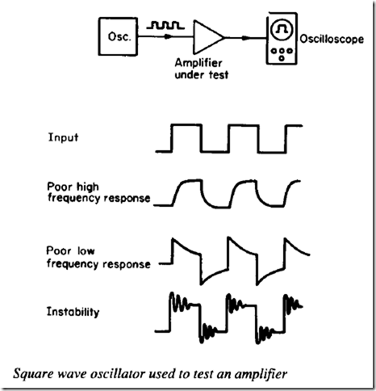
Frequency response test of amplifiers
Loss of the sharpness at the edges of the waves shows that the amplifier response is limited at the higher frequency range.
http://www.engineering-bachelors-degree.com/electronic-components/uncategorized/square-wave-oscillators-and-op-amp-square-wave-oscillator/

Slide 11
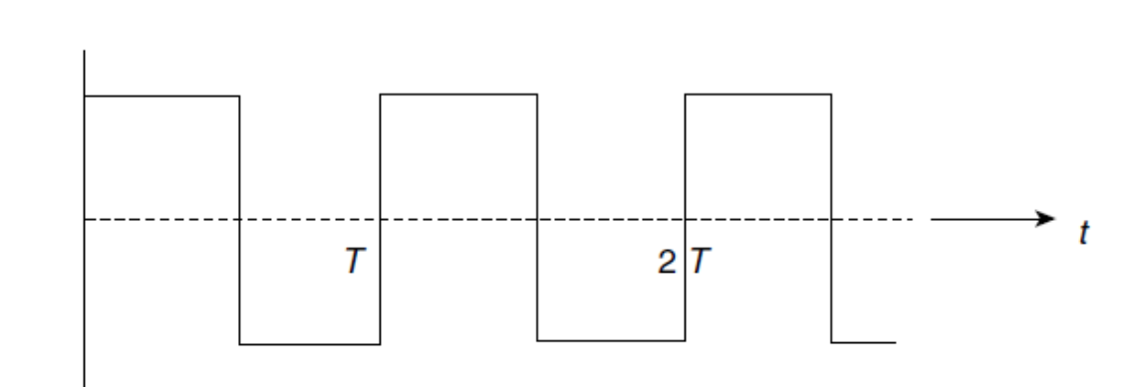
Constant is zero (symmetry around x axis).
Represented by odd function (sine function).
More than 3 harmonics required to faithfully represent the edge sharpness.
Constant is not zero (asymmetry around x axis).
Represented by even and odd functions.
More than 3 harmonics required to faithfully represent the edge sharpness.

Slide 12
Fourier Series for any interval
Any section or interval of a well behaved function may be chosen and expressed in terms of Fourier Series.
This series will accurately represent the function only within the chosen interval.
If the interval is represented by a Fourier cosine series the repetition will be that of an even function, if the representation is a Fourier sine series and odd function repetition will follow.

Slide 14
Arguments in terms of phase angles
So far the arguments of cosine and sine functions are given as x assumed to be measured in radians.
However, if x is assigned as a distance the a factor of 2π/l is needed to transform the distance into an angle unit. With this factor, when x = l, the phase angle changes by 2π.
For example, an original function shown in the figure below can be represented as a sine series (odd function) over a half interval [0,l/2]

Slide 15
The given function can be represented by the sine series as follows,
Note : only the behavior of the function within the half interval 0 to l/2 can be described by f_{o}(x)

Slide 16
Q: Application of Fourier Sine Series to a Triangular Function
The figure below shows a function which we are going to describe by a sine series in half-interval 0 to π. The function is
This function defined over a limited interval can be used to described the behavior of a plucked string.
Notes:
In this problem x already represents in radians. Therefore no need to introduce the factor 2π/l into the argument.

Slide 17
A: Application of Fourier Sine Series to a Triangular Function
Fourier sine series is chosen to represent the half interval of a triangular function
b_{n} : coefficients of the odd part
Permitted harmonics of the plucked string
***

Slide 18
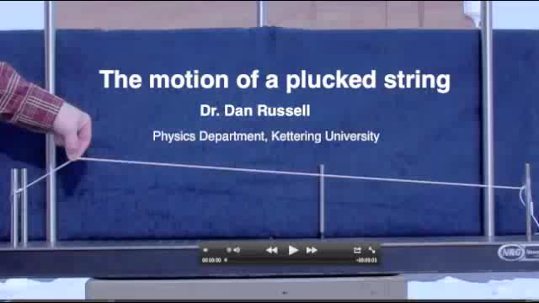
https://www.youtube.com/watch?v=_X72on6CSL0

Slide 19
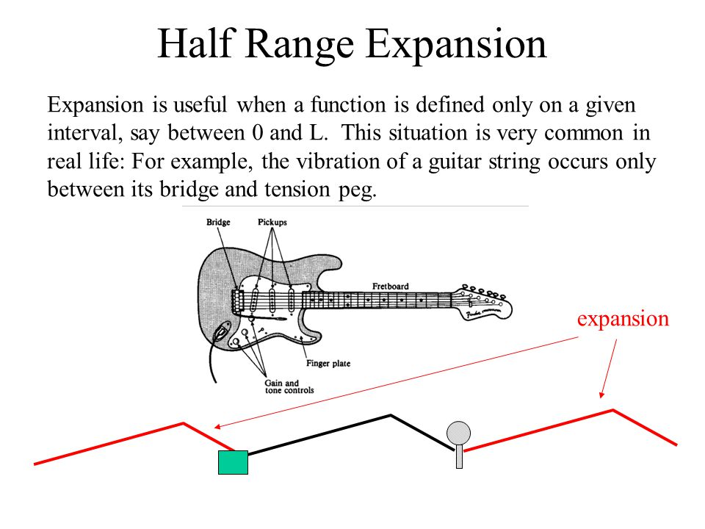
http://slideplayer.com/slide/6018598/20/images/5/Half+Range+Expansion.jpg

Slide 20
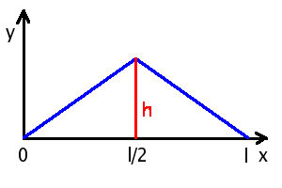
Application to the energy in the normal modes of a vibrating string
If we take a string of length l with fixed end and pluck its center a distance d, we have a triangular configuration of the a interval as shown in the figure below.
According to the previous section, this configuration expected to be represented by the Fourier sine series.
d
http://users.aber.ac.uk/ruw/teach/260/wave2.php

Slide 21
Under this particular situation, the series representing the plucked string at time t is equivalent to the total displacement of the normal modes or standing waves occurring once the string is released.
To find the displacement of a normal mode or standing wave vibration, the following standing wave equation has to be solved using the method of separation of variable.
The wave equation :
The solution that fits the boundary condition; i.e., y(x = 0, t) = y(x= l, t) = 0, is found to be
Derive this!
Notes:
The expression of the wave equation given here is just in a general form.
Later a particular wave function (solution of the wave equation) will be worked out.

Slide 22
Derivation of a normal mode wave function in summary
Possible solution may be given by y(x,t) = X(x).T(t)
By substituting the solution back into the wave equation, rearrange the equation and equate each side of the equation to a constant, we then end up with two linear ODE as follows,
This leads to

Slide 23
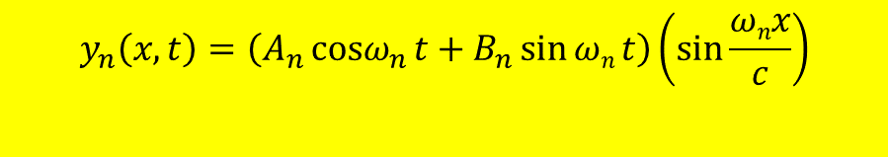
Expression of a normal mode wave function
From the derived general forms of the normal mode wave function, a particular form can be obtained once the boundary condition, i.e. y(0,t) = y(l,t) = 0 is considered.
Apply y(0,t) = 0
For a normal mode n, the expression may be written as
Apply y(l,t) = 0
$$y_{n}\left(x,t\right)=\left(A_{n}{cosω}_{n}{t}+B_{n}\sin{ωn}t\right)\left(\sin{\frac{ωnx}{c}}\right)$$
Notes:
Yn here actually the fourier ser

Slide 24
The total displacement, which represents the shape of the plucked string at t, is given by summing the normal modes
The arbitrary constants A_{n} and B_{n} have to be determined.
Recall the initial conditions at t = 0; i.e., y ≠ 0 and v = dy/dt = 0 ( stationary plucked string)
To obtain the representation of the series that satisfies the initial condition at t = 0, the total displacement is rewritten as
Fourier series of displacement

Slide 25
The velocity of the string at time t = 0.
Both displacement y₀(x) and velocity v₀(x) at t = 0 can be written in the form of Fourier sine series.
Generally, A_{n} and B_{n} can be determined for a string of length l from
Fourier series of velocity
Derive this!
Notes:
Vo(x) obtained above becomes zero to comply with the initial condition if Bn = 0.

Slide 26
Determination of the Fourier coefficients
Fourier coefficient A_{n} of displacement y₀(x),
Similarly, the Fourier coefficient ω_{n}B_{n} can be obtained.
TRY THIS!

Slide 27
To obtain particular forms of A_{n} or B_{n}, the displacement function of the plucked string has to be clearly stated.
Referring to the figure, the displacement of a string length l, center plucked a distance d is given by
Due to the plucked string released from rest (v₀(x) = 0), B_{n}’s are zero.
Only A_{n}’s are of interest and found to be
Therefore, the total displacement can be written as
d
Only n odd is considered.
Notes:
Bn is the coefficient of the velocity.

Slide 28
Recall the energy in each of normal modes of standing wave vibration,
Because B_{n}’s are zero, the energy of nth mode of vibration can be written as
The total vibrational energy of the string is given by
Or where
From *** in p.17
In summary,
A plucked string can be represented by a Fourier sine series.
In the absence of dissipation, the total vibration energy must equal to the potential energy of the plucked string before release.
The energy nth mode is proportional to n⁻². Higher modes contribute less energy to the vibration.
Even modes are forbidden by the initial boundary conditions
Notes:
สังเกตว่า normal mode ยิ่งสูงขึ้นพลังงานที่จะช่วย contribute ต่อพลังงานรวมยิ่งน้อยลง
เหตุผลที่มีแต่ odd mode หรือ sine fourier series เพราะ boundary condition.
สิ่งที่เราคำนวณได้นี้เป็นพลังงานศักย์ขณะที่ทำการ plucked string ถ้าไม่คิดว่ามีการ dissipation ของพลังงานขณะ vibrate ค่าพลังงานนี้ก็จะเท่ากันตลอดการสั่น
แต่ในทางปฏิบ้ติไม่เป็นเช่นนั้น เนื่องจากมีแรงเสียดทาน จึงการสูญเสียและลดลงของพลังงาน จนการสั่นหยุดไปในที่สุด
Here T = tension = mc^2//

Slide 29
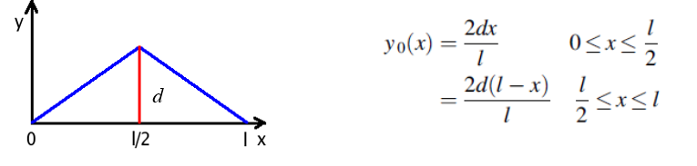
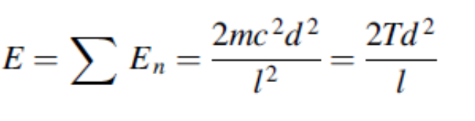
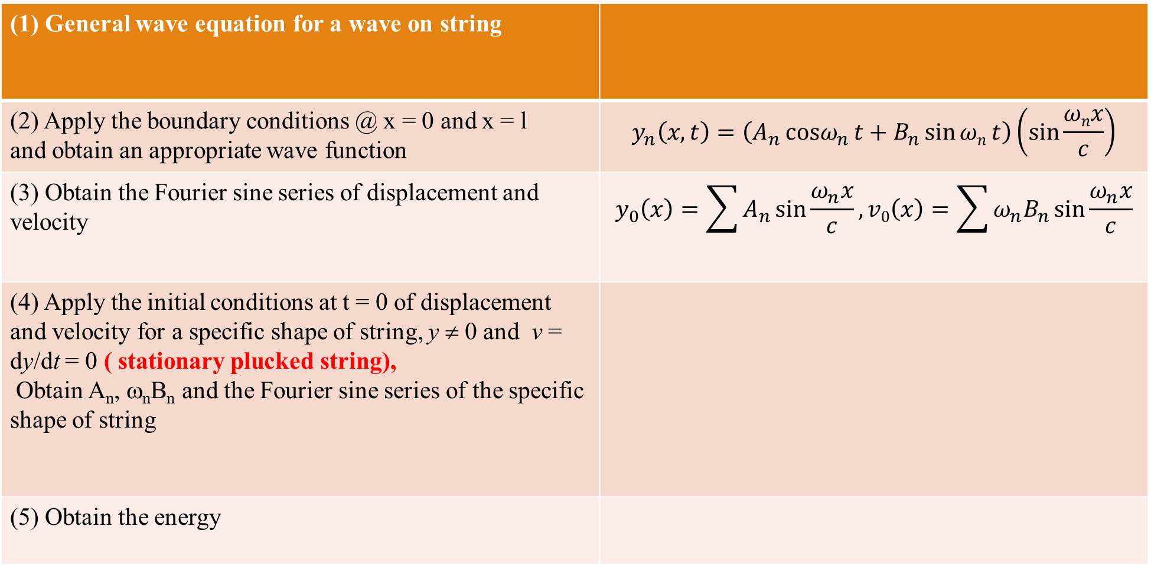
Summary
(1) General wave equation for a wave on string
(2) Apply the boundary conditions @ x = 0 and x = l and obtain an appropriate wave function | $$y_{n}\left(x,t\right)=\left(A_{n}{cosω}_{n}{t}+B_{n}\sin{ωn}t\right)\left(\sin{\frac{ωnx}{c}}\right)$$
(3) Obtain the Fourier sine series of displacement and velocity | $$y_{0}\left(x\right)=\sum{A_{n}\sin{\frac{ω_{n}x}{c}}}, v0\left(x\right)=\sum{{ω_{n}B}_{n}\sin{\frac{ω_{n}x}{c}}}$$
(4) Apply the initial conditions at t = 0 of displacement and velocity for a specific shape of string, y ≠ 0 and v = dy/dt = 0 ( stationary plucked string), Obtain A_{n}, ω_{n}B_{n} and the Fourier sine series of the specific shape of string
(5) Obtain the energy

Slide 30
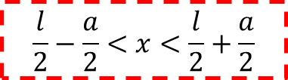
Fourier series analysis of a rectangular velocity pulse on a string
A string of length l, fixed at both ends, is struck by a mallet of width a about its center point.
The initial condition at the moment of impact in terms of displacement and velocity are given as
$$\frac{l}{2}−\frac{a}{2}<x<\frac{l}{2}+\frac{a}{2}$$

Slide 31
Recall the previous situation of the plucked string, arbitrary constants A_{n} and B_{n} can be found from
However, in this case, A_{n}’s are zero. (WHY?)
This gives
Therefore,
Note: we can start solving the problem from step 4 according to the summary table
Notes:
Boundary condition ของทั้ง plucked string (กรณีที่แล้ว) กับ hit string (กรณีนี้) เหมือนกัน กล่าวคือ y(0,t) = y(l,t) = 0
An’s are zero because at t = 0 displacement = 0. This forces the An to be zero.

Slide 32

Only n odd is considered. Thus,
The total energy of vibration is found from the summation of energy per mode of oscillation.
The expression shows that again the energy of nth mode is proportional to n⁻² (because ω_{n} = nπc/l) and decreasing with increasing harmonic frequency.
The energy of mode nth can be rewritten in terms of angular frequency ω_{n} as
where
$$∵ω_{n}=\frac{nπc}{l}$$
;
How does the distribution of the energy look like?
Notes:
ผลสรุปเหมือนกรณีของ plucked string กล่าวคือ energy ของ normal mode มีค่าลดลงตาม mode number ที่เพิ่มขึ้น โดยแปรตาม n^-2
หรือกล่าวได้ว่า ยิ่ง mode สูงขึ้น พลังงานยิ่งน้อยลง

Slide 33
Energy spectrum of the harmonic ω_{n}
The curve of sin²α/α² appears as the envelope of the energy values for each ω_{n}.
The true shape of the spectrum
The first zero of the envelop occurs when
Notes:
The first zero is found when En(ω) = 0. This occurs when α= π and this leads to ω =2πC/a.

Slide 34
What do we learn from the energy spectrum?
The major portion of the energy in the velocity pulse is to be found in the low frequencies.
The width (measured from the highest energy to the first zero of the energy) of the central
frequency pulse contains most of the energy.
This range of energy-bearing harmonics is known as the spectral width of the pulse given as
For any spatial width a = Δx, the spectral width becomes
Because Δt = Δx/c, this gives ΔωΔt ≈ 2π or ΔνΔt ≈ 1 knows as the Bandwidth Theorem.
Notes:
ΔxΔω = 2π implies that reducing the width Δx of the mallet, the range of frequencies Δω will be increased.
Bandwidth theorem states that narrow Δt wider Δω.

Slide 35
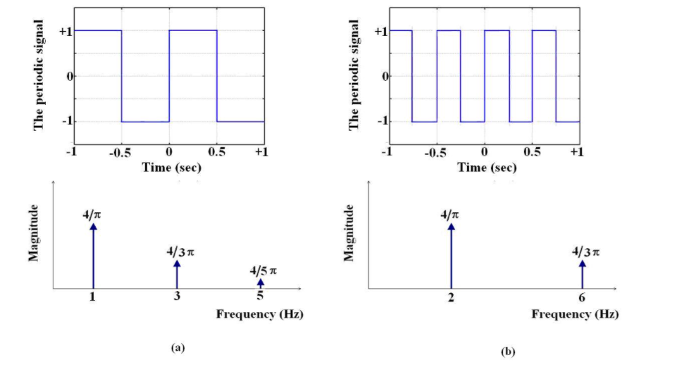
The periodic square wave with period of 1sec, and its corresponding spectrum,
(b) The square wave with period reduced to 0.5 second and its corresponding spectrum.
The relation just follows the bandwidth theorem , ΔνΔt ≈ 1.
https://cnx.org/contents/cvkPOvcs@1/Fourier-Series-Square-wave

Slide 36

http://slideplayer.com/slide/8408101/26/images/26/Maybe+we+could+hit+YOUR+BRAIN+with+our+radiowave+hammer%E2%80%A6.jpg
Applying the concept Fourier series analysis of disturbed wave to MRI

Slide 37
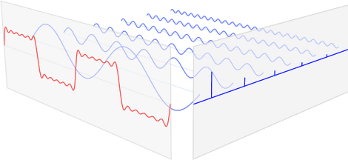
The frequency spectrum of Fourier series
The Fourier series can always be represented as a frequency spectrum.
frequency
time
This relation explains the wider interval between the adjacent odd harmonics in a shorter string.
https://tex.stackexchange.com/questions/127375/replicate-the-fourier-transform-time-frequency-domains-correspondence-illustrati%3E
Notes:
ω_{n+1} = (n+1)πc//
ω_{n} = (n)πc//
∴ω_{n+1} - ω_{n} =Δω= πc// which corresponds to the energy interval. Notice that as l is shorter, Δω becomes wider.

Slide 38
Fourier series to Fourier Integral (1)
Recall the Fourier representation in the exponential form
Using the time as a variable, the Fourier representation is rewritten as
The coefficient d_{n} can be found from
Given ω = 2πν₁ and T is the period, the Fourier series becomes
Derive this!

Slide 39
Fourier series to Fourier Integral (2)
The conversion of the Fourier series to Fourier integral is based on following assumptions :
The period T approaches infinity,
The frequency ν₁ = 1/T → 0 and 1/T becomes infinitesimal and may be written as dν,
nν₁ = ν,
The unit change in n becomes an infinitesimal change.
The Fourier integral is therefore written as
Notes:
The concept is now if we want to present a non periodic in the form a series.
We just consider the non periodic function as a periodic function with a period approaching infinity.
Therefore, the expression of the fourier series has to be changed to an integral form.
From the integral we also found that there are pair of function relating to each other.
We call those forms as Fourier transforms.

Slide 40
Fourier integral and Fourier transform
When f(t) is non-periodic, the infinite number of frequency components in the integral form (not the sum) can be written as
Where
is called Fourier transform of f(t).
This shows that integration with respect to one variable produces a function of the other.
Both variable forms Fourier pair of transform and the product is non dimensional.

Slide 41
Example of Fourier transform : slit function
Function of narrow slit extending d in time and of height h
Notes:
Fourier transform pairs : time and frequency

Slide 42
Example of Fourier transform :
The Gaussian curve
The Gaussian function of height h is symmetrically centered at t =0 is given by
σ is the width parameter.

Slide 43
As height h → 0, the width σ → 0.
The normalized Gaussian function becomes infinitely narrow which defines the Dirac delta (δ) function.
The transform covers an increasing frequency components.
Height of the function

Slide 45
Homework #11
10.3, 10.4

